Slide 1

Market Churn
Team Member (In order of presentation):
Wei Guo
Sumithra Hariguruprasad
Shubhada Gopale
Rozhan Makhdoomi

Slide 2
1
Define the Issue
2
Data Preparation
3
Modeling
Model 1: Naïve Bayes
Model 2: Decision Tree
Model 3: KNN
Model Evaluation and Comparison
4
Conclusion

Slide 3
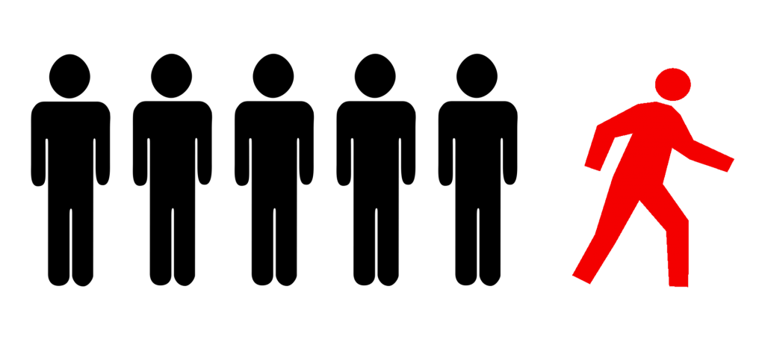
Background
It costs more to attract new customers than to retain existing customers
The telecom company wants to understand which customers would churn in near future
After characterizing customer churn, action would be taken to retain them
Notes:
Wei

Slide 4
1
Define the Issue
2
Data Preparation
3
Modeling
Model 1: Naïve Bayes
Model 2: Decision Tree
Model 3: KNN
Model Evaluation and Comparison
4
Conclusion

Slide 5
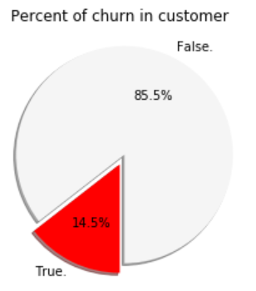
Facts
50% of the clients have area code 415. Similar percent of customer churn in the three area codes
Average clients remain in the company for 101 months
The average total charge per customer is around $60, more than half from Day charge
Each customer had an average 305 calls in the course of using the service of this company
79% of the clients has called the customer service at least one time, but majority have only 1-2 calls
Notes:
Wei

Slide 6
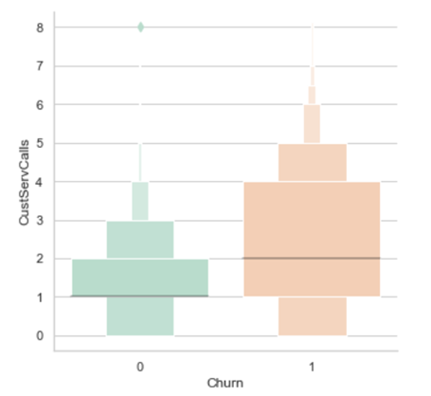
Churn clients have higher average calls to customer service
Notes:
Wei

Slide 7
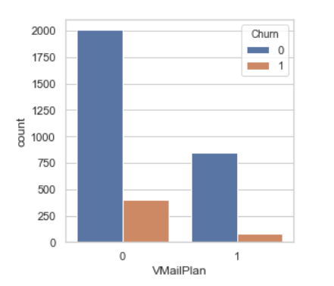
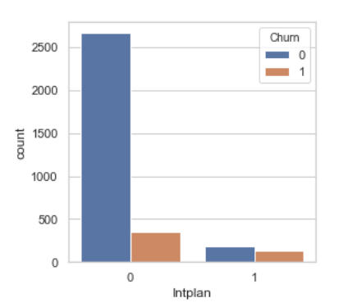
Compared to International plan, clients with Voicemail Plan has lower churn rate
Notes:
Wei

Slide 8
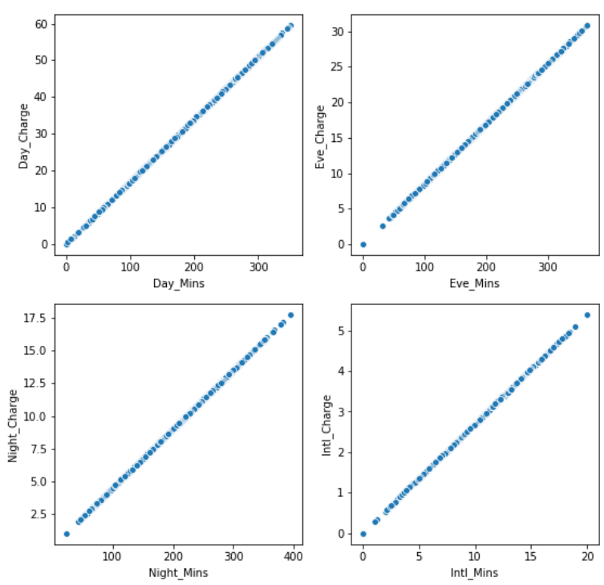
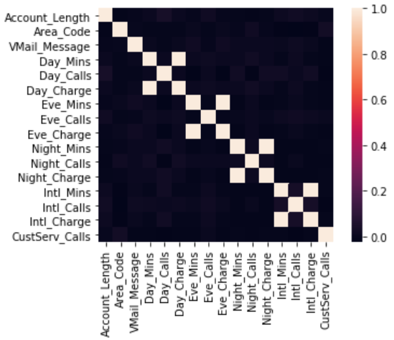
Correlation
Correlation between metrics
High correlation between:
Day_charge & Day_Mins
Eve_charge & Eve_Mins
Night_charge & Night_Mins
Intl_charge & Intl_Mins
Drop 'Day_Charge’, 'Eve_Charge’, 'Night_Charge', 'Intl_Charge'
Notes:
Wei

Slide 9
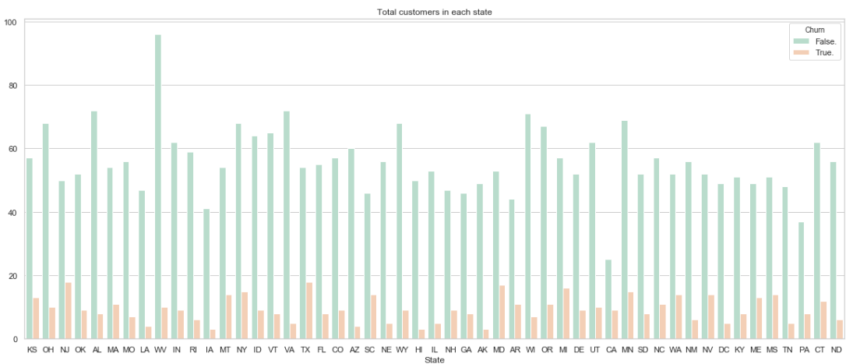
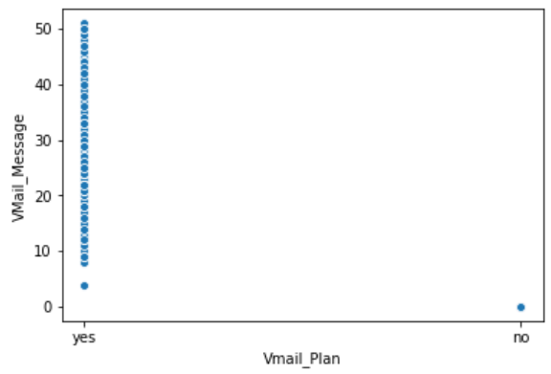
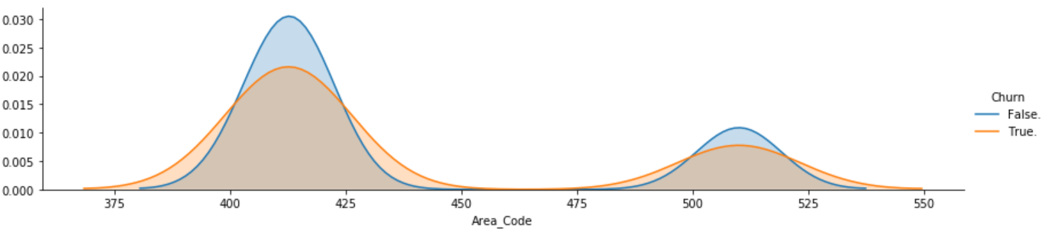
Variable Dropped
Variable | Distribution | Note
State |  | Drop “State”
Vmail_Plan & Vmail_Message |  | High correlation between Vmail_Plan & Vmail_Message Drop “Vmail_Plan”
Area Code |  | Drop “Area Code”
Notes:
Sumithra

Slide 10
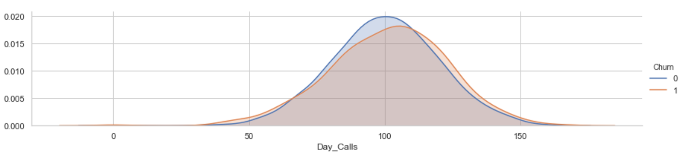
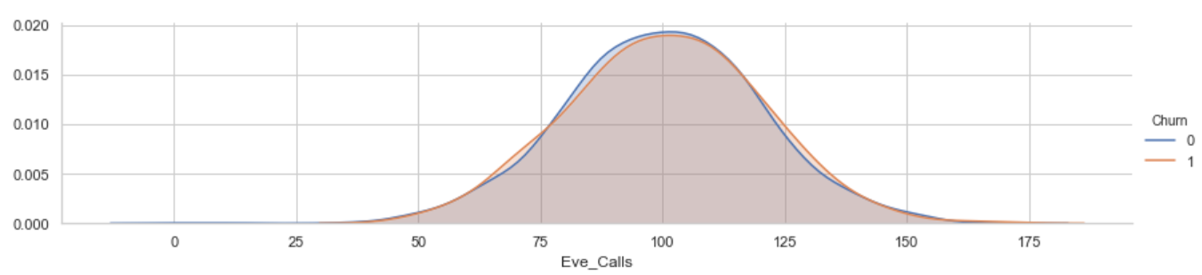
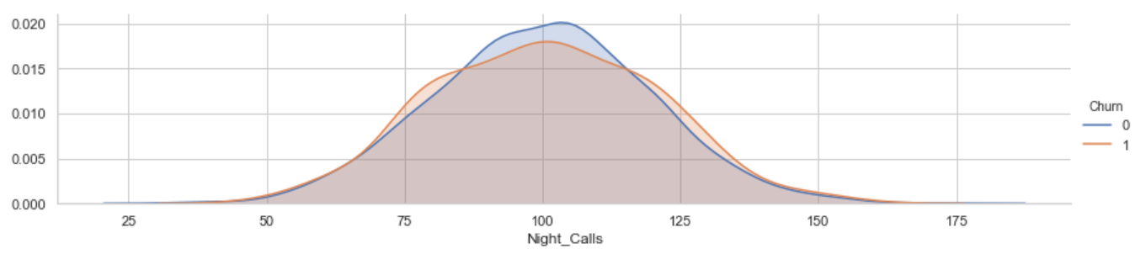
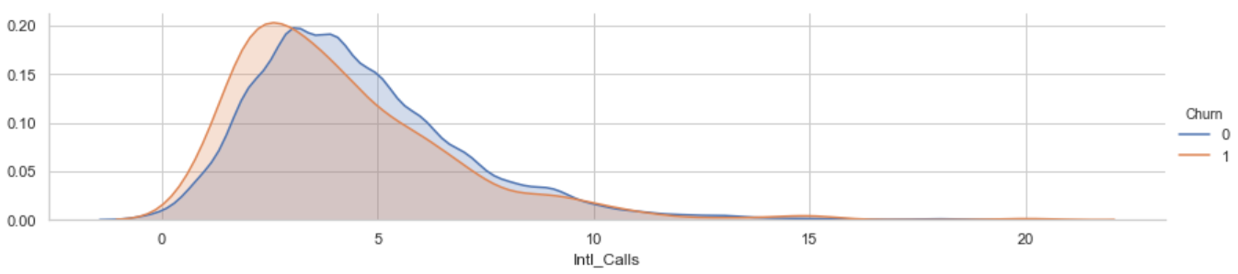
Variable Dropped (Cont.)
Variable | Distribution | Note
Day_Calls, Eve_Calls, Night_Calls, Intl_Calls |  | No big differences between Churn and not Churn Drop “Day_Calls”, “Eve_Calls”, “Night_Calls”, “Intl_Calls”
Other areas dropped: Phone
Notes:
Sumithra

Slide 11
Features used in the models:
Input: | Account Length | Day Mins | Eve Mins | Intl Mins
 | Night Mins | Intl Plan | Vmail message | CustServ Calls
Outcome: | Churn
Data Split and Validation:
Dataset
70%: Train Set | 30%: Test Set
Validation Set K-fold, K=10
Notes:
Sumithra

Slide 12
1
Define the Issue
2
Data Preparation
3
Modeling
Model 1: Naïve Bayes
Model 2: Decision Tree
Model 3: KNN
Model Evaluation and Comparison
4
Conclusion

Slide 13
Measuring Metric Chosen
Metrics | Description | Pros / Cons
Accuracy | It is the percentage of correct predictions. | Works better if there is an equal number of samples in each class An Unbalanced class distribution in a dataset can give a false sense of high accuracy.
Precision | True Positives/True Positives + False Positives | It is good measure when there is high cost associated with false positives
Recall | True Positives/True Positives + False Negatives | It is good measure when there is high cost associated with false negatives
F1 score | F1 which is a function of Precision and Recall i.e The hormonic average of precision and recall | It is a better measure to use if we need to seek a balance between Precision and Recall
Notes:
Sumithra
To put in very simple words when you have a data imbalance i.e., the difference between the number of examples you have for positive and negative classes is large, you should always use F1-score

Slide 14
1
Define the Issue
2
Data Preparation
3
Modeling
Model 1: Naïve Bayes
Model 2: Decision Tree
Model 3: KNN
Model Evaluation and Comparison
4
Conclusion

Slide 15
Model 1: Naïve Bayes
Naïve Bayes algorithm is based on Bayes’ theorem with strong (naive) independence assumptions between the features
Pros : It is simple, fast and easy to implement.
Cons: The assumption of independent features.
Evaluation Accuracy:0.849 Test Accuracy:0.845
 | Precision | Recall | F1-Score | support
No Churn | 0.89 | 0.93 | 0.91 | 847
Churn | 0.49 | 0.38 | 0.43 | 153
Avg/total | 0.83 | 0.84 | 0.84 | 1000
Notes:
Sumithra

Slide 16
Model 2: Decision Tree
Simple to understand, interpret and visualize
Can handle both numerical and categorical data
Parameter | Validation Accuracy | Test Accuracy | Churn Recall
Depth=4 | 0.917 | 0.906 | 0.50
Depth=7 | 0.921 | 0.927 | 0.68
Unpruned | 0.887 | 0.894 | 0.70
Notes:
Shubhada

Slide 17
Model 3: KNN
K-NN is non-parametric lazy learning algorithm
Pro: Does not assume any probability distributions on the input data
Con: If one type of category occurs much more than another, classifying an input will be more biased towards that one category
Parameter | Validation Accuracy | Test Accuracy
N = 3 | 0.867 | 0.859
N = 5 | 0.885 | 0.874
N = 7 | 0.887 | 0.874
Notes:
Shubhada

Slide 18
1
Define the Issue
2
Data Preparation
3
Modeling
Model 1: Naïve Bayes
Model 2: Decision Tree
Model 3: KNN
Model Evaluation and Comparison
4
Conclusion

Slide 19
Model Comparison
Model | Validation Accuracy | Test Accuracy | Diff (Validation vs. Test)
Model 1: Naive Bayes (Gaussian ) | 0.850 | 0.845 | 0.005
Model 2: Decision Tree | 0.921 | 0.927 | -0.006
Model 3: KNN (N = 5) | 0.885 | 0.874 | 0.011
Notes:
Shubhada

Slide 20
1
Define the Issue
2
Data Preparation
3
Modeling
Model 1: Naïve Bayes
Model 2: Decision Tree
Model 3: KNN
Model Evaluation and Comparison
4
Conclusion

Slide 21
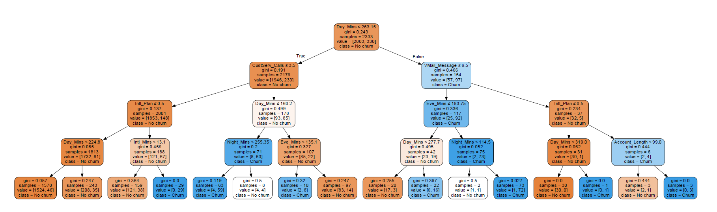
Decision Tree Visualisation
Decision Tree results can help us find the groups are more likely to churn
Notes:
Shubhada

Slide 22
Conclusion
Customers having high talk time in peak hours or making more international calls and calling Customer Service more than 3 times are more likely to churn
To be specific: Customers having day talk time(>263 mins), evening talk time(>266 mins), International mins(>7 mins) on regular basis and have made more than 3 customers calls are more likely to churn
Customers having a International plan and not having a Vmail Plan are more likely to churn
To retain the at-risk customers:
Targeting the group above by giving special offers right away
To prevent clients being at-risk:
Better pricing: Create bundle packages for clients with longer talk time in peak hours and international. Promotions on Vmail Plans.
Reduce client issues: Dig deeper into service calls to find the reason for clients to make multiple attempt
Notes:
Shubhada

Slide 23
Thank you!

Slide 24
Appendix

Slide 25
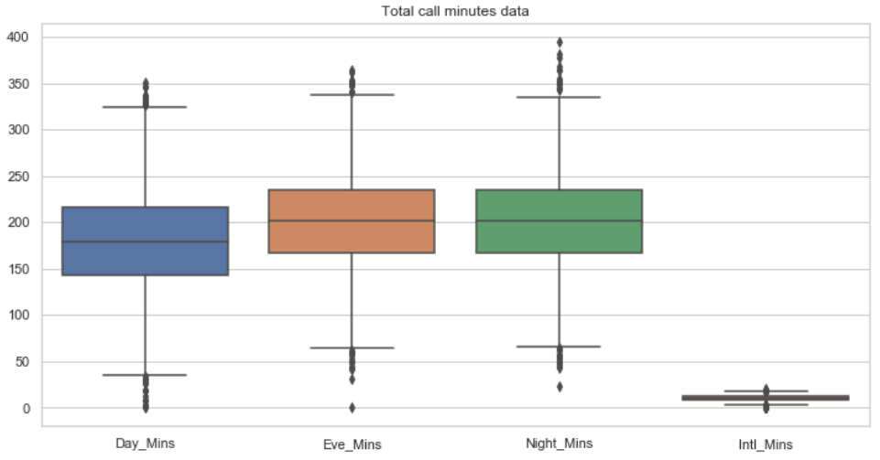
Question 1: Is there any outlier?

Slide 26
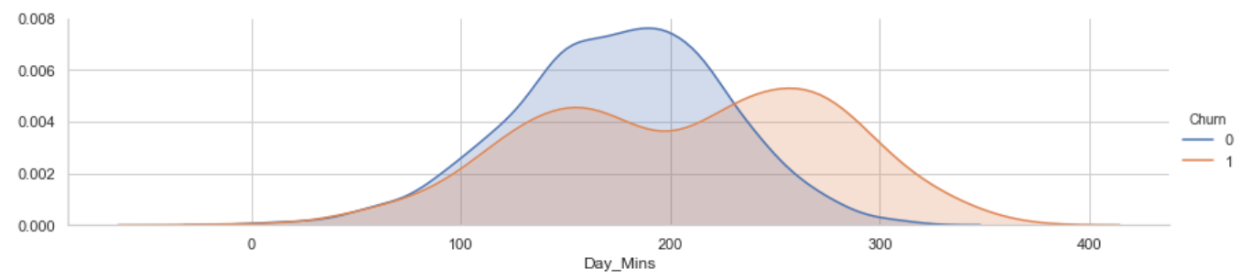
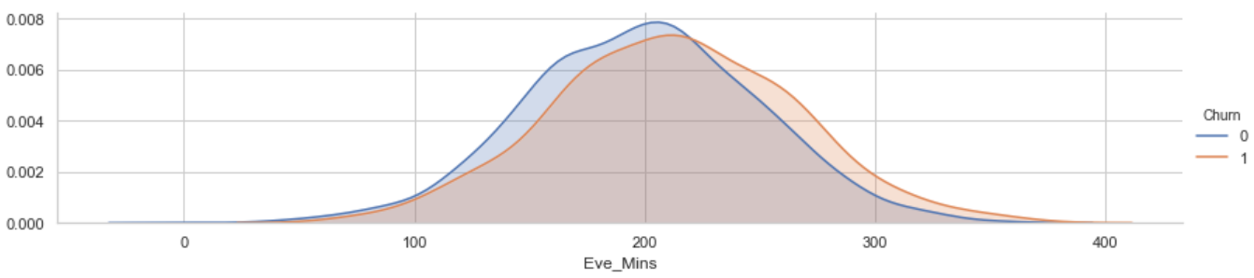
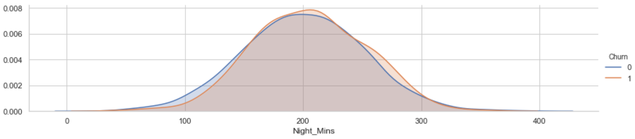
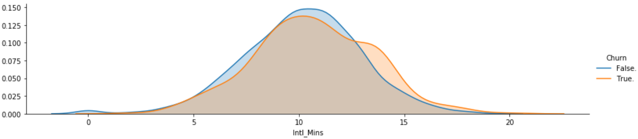
Question 2: Why not creating the Total_Mins?
Variable | Distribution | Note
Day_Mins, Eve_Mins, Night_Mins, Intl_Mins |  | The Churn split results are different for three metrics Keep the four instead creating a “Total_Mins” metric

Slide 27
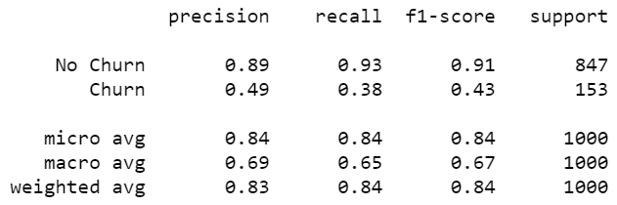
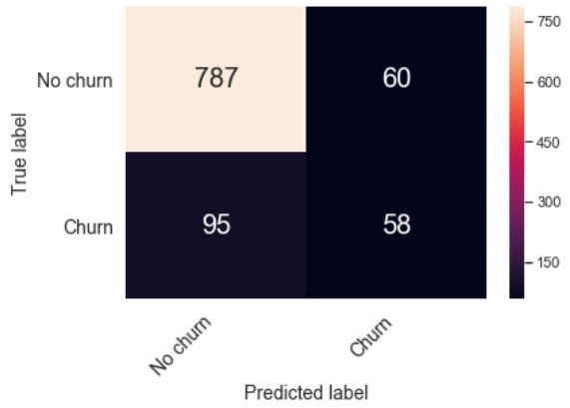
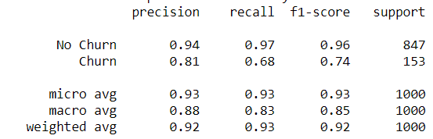
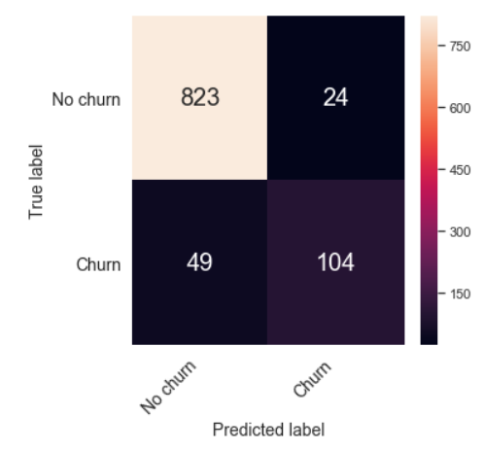
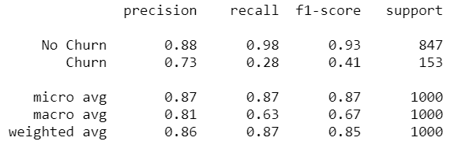
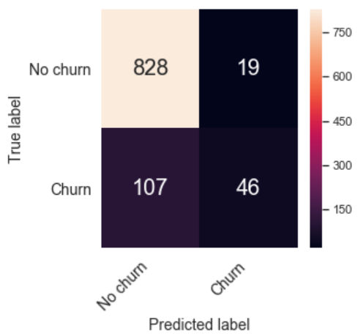
Question 3: What’s the result of other performance measures?
 | Other Performance Measures | Confusion Matrix Results
Model 1: Gaussian Naive Bayes
Model 2: Decision Tree
Model 3: KNN

Slide 28
Question 4: What’s the thought process for the analysis?
Correlating.
We want to know how well does each feature correlate with Churn.
Completing.
We do not have any null value in this data set so we do not need to complete any of the variables.
Correcting.
phone number and area code may be dropped from our analysis as there may not be a correlation between phone number and churn.
State feature may be dropped as it does not contribute to churn.
Creating.
We may want to create a new feature called total charges based on partial charges to get total revenue of the company from each customer.
We may want to create a new feature called total calls based on partial calls to get total calls of each customer.
We may want to create a new feature called total minutes based on partial minutes each customer talked to get total usage of the each customer.
We may want to change the Intplan,VMailPlan,Churn from yes/no to 0 and 1 categorical variables.
Classifying.
Then we will classify the model

Slide 29
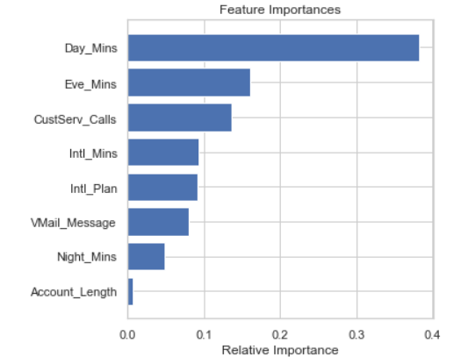
Feature Importance

